Slide 1
Software Testing
Presented by :-
Sakshi. M. Badmanji - U15BL23S0103
Shradha .S. Malai - U15BL23S0342
Praveen. T. Katare - U15BL23S0392

Slide 2
Introduction
Software testing is the process of evaluating and verifying that a software application or system meets specified requirements and functions correctly. The main goal is to find defects and ensure the software is reliable, efficient, and meets user expectations.

Slide 3
Importance of Software Testing
Error Detection
Cost- Effectiveness
Improves Security
Customer Satisfaction

Slide 4
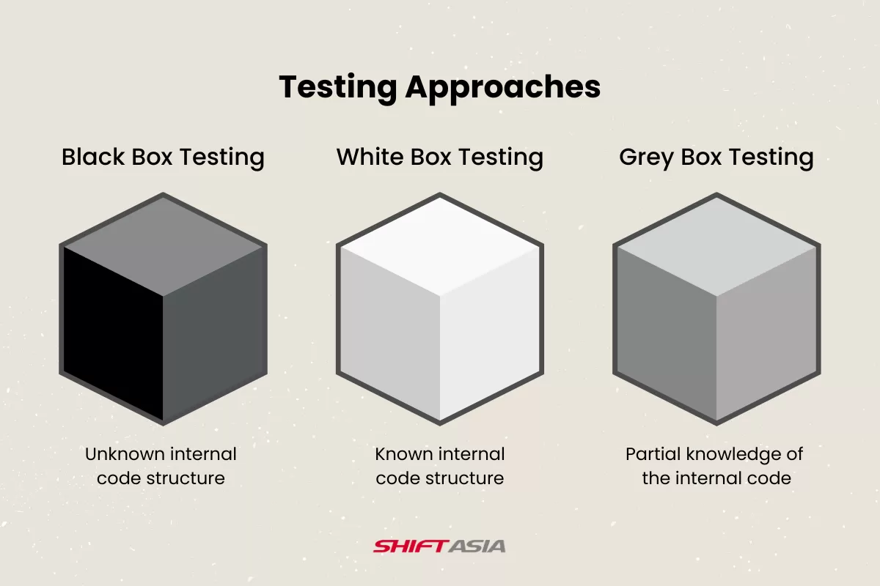
Types of Software Testing
White Box Testing
Black Box Testing
Gray Box Testing

Slide 5
Software Testing Level
Unit Testing : Unit is the smallest testable part of an application. This tests finds problems early in development cycle.
Integration Testing : Integration Testing combines unit tested modules and tests how they interact. Any errors discovered when combining units are likely related to the interface between units.
System Testing: It involves the external workings of the software from the user’s perspective. It falls under the black box testing category of software testing.
Acceptance Testing: Acceptance testing is usually done at client location by the client . It focuses on not to find defects but to check whether the system meets the client requirements.

Slide 6
Software Testing Life Cycle (STLC)
Requirement Analysis:
Review software requirements and specifications .Identify testable requirements. Clarify doubts with stakeholders.
Test Planning:
Define testing scope, objectives, and schedule. Identify resources (personnel, tools, infrastructure). Determine testing approach (manual/automation).
Test Case Design:
Create test cases based on requirements. Use techniques (equivalence partitioning, boundary value analysis). Review and refine test cases.

Slide 7
Environment Setup:
Prepare testing environment (hardware, software, network). Install necessary tools and configurations. Ensure test data availability.
Test Execution:
Run test cases according to plan. Log defects and report issues. Re-test fixed defects.
Test Closure:
Summarize testing activities. Document test results. Evaluate testing effectiveness. Identify areas for improvement.

Slide 8
Thank You

